Slide 1



In-house Teams' ChatGPT
Set up guide

Slide 2
In-house Teams' ChatGPT
Step 1:
Open Microsoft Teams and click on the "Apps" icon located on the left panel
Step 2:
click "Open". You can also click on the APP card to learn more about this APP

Slide 3
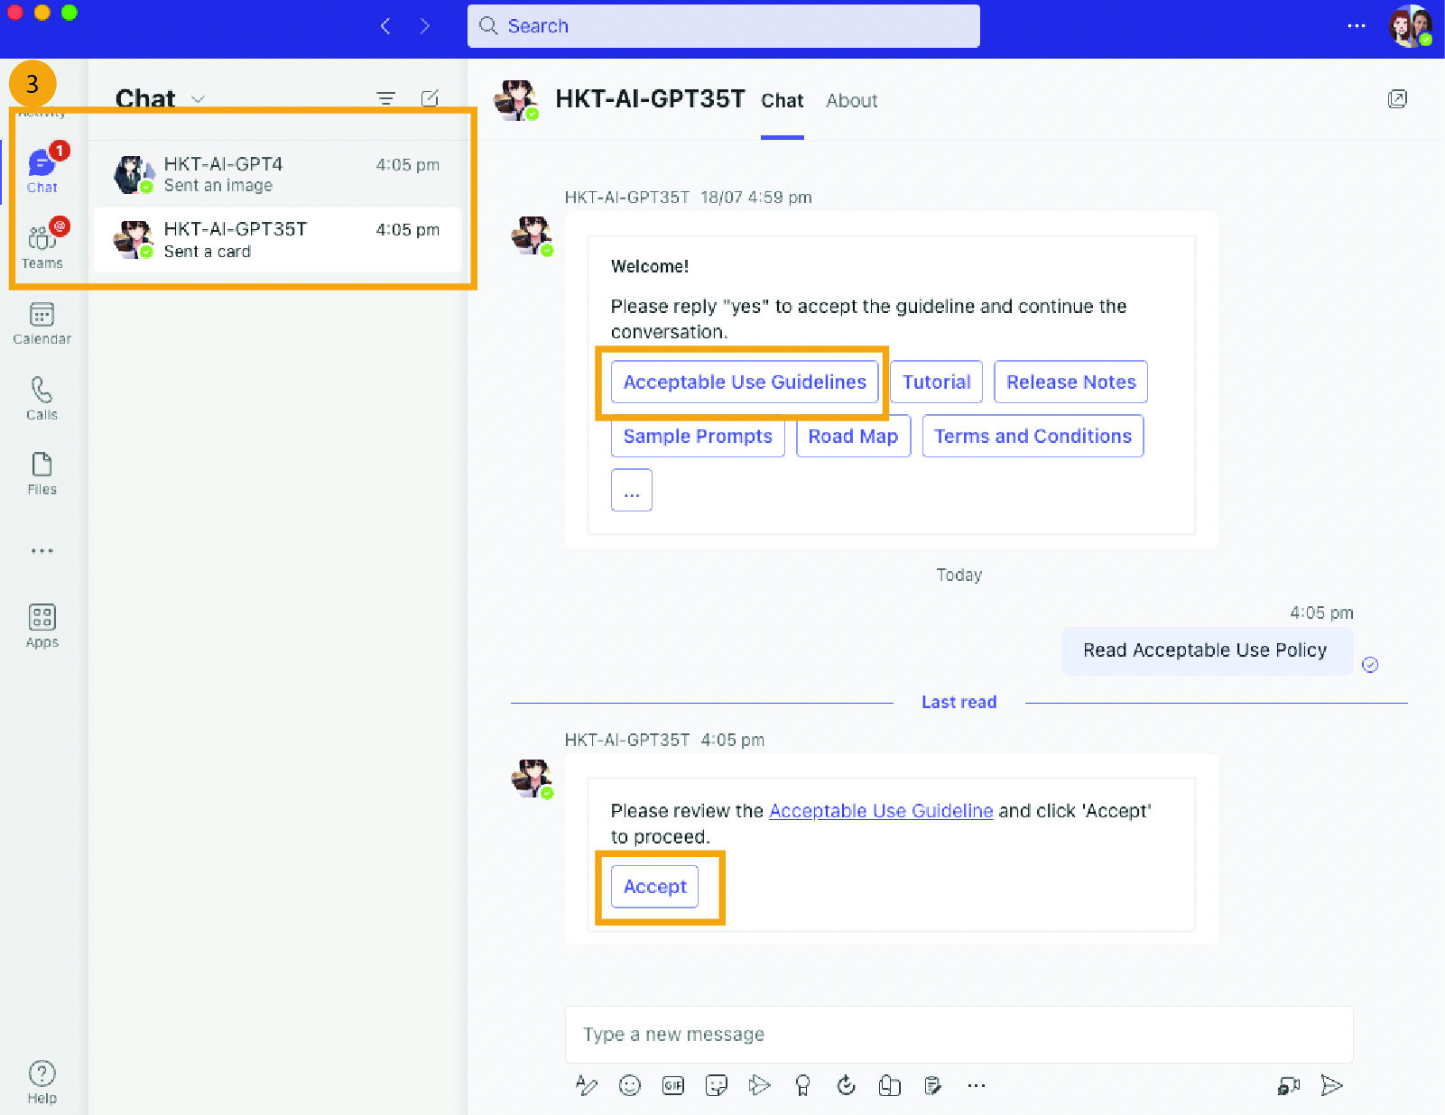
In-house Teams' ChatGPT
Step 3:
After opening the application, you will be directed to a chat with the selected Chatbot.
Please click on "Acceptable Use Guidelines" and then click "Accept" to proceed.

Slide 4
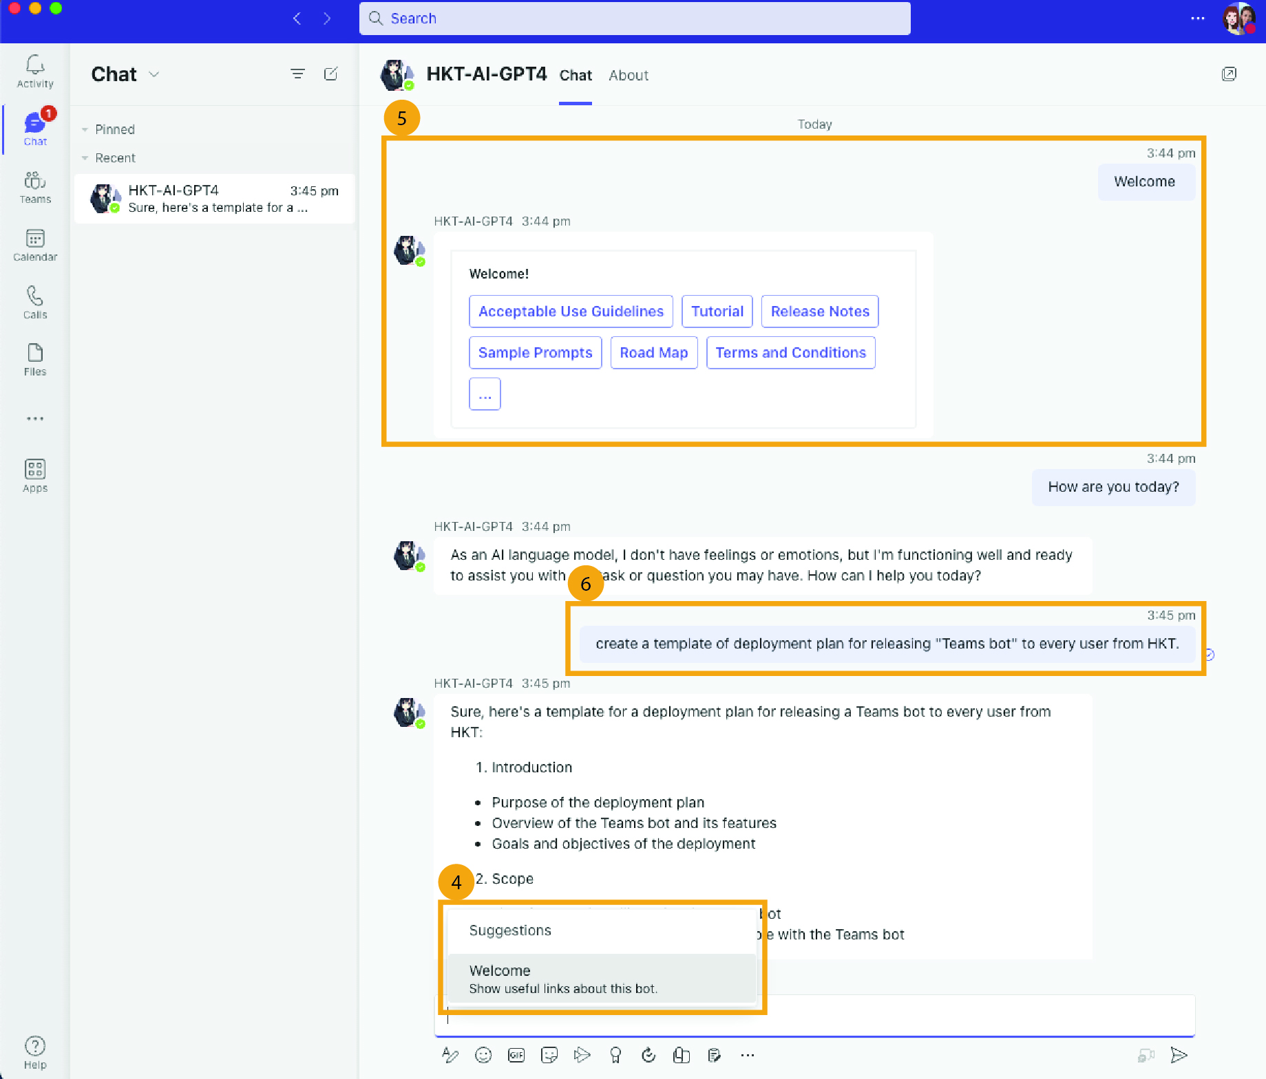
In-house Teams' ChatGPT
Step 4:
Type in "Welcome" to initiate the conversation
Step 5:
The bot will then display useful links for you to explore
Step 6:
Type your tasks and questions and bot will assist you.

Slide 5
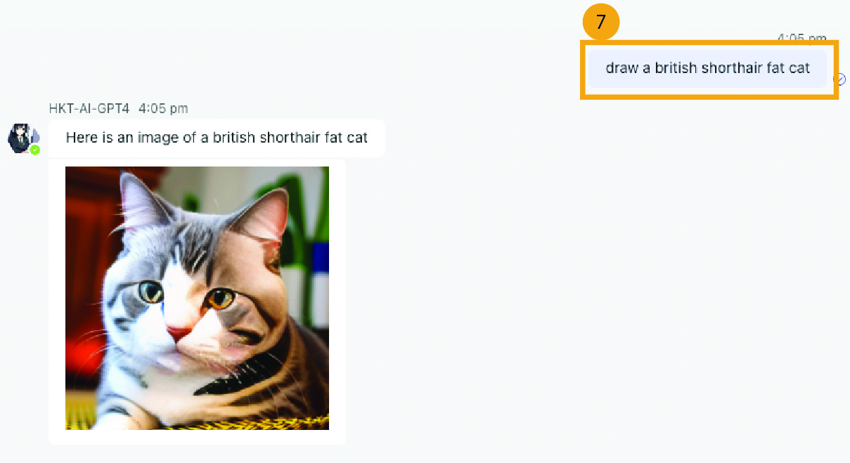
In-house Teams' ChatGPT
Step 7: (Feature)
Image Generation
If you would like the bot to draw something, simply start your message with "draw". The bot will then respond and create a drawing based on your request.

